Slide 1
Home Learning
Year 4 – 8.6.20

Slide 3
This Week’s Reading Books
I have allocated your reading books on Active Learn.
https://www.activelearnprimary.co.uk/start
This weeks reading books are:

Slide 4
Monday

Slide 5
Mathematics
My Maths – Measuring Lengths.
www.mymaths.co.uk

Slide 6
Literacy - Watch the film clip – A Cloudy Lesson!
https://youtu.be/-45TbOGadro

Slide 7
Literacy - Question Time!
Pause the film before the title scene ‘A cloudy lesson’ where the house in the clouds is visible.
What is strange about this house?
Pause the film before the old man blows through the ring.
Is this an old or young man? How do we know?
What might their relationship be?
What do you think he is going to use this tool for?
Pause the film after the old man blows the 1st cloud and gestures the boy to do the same.
Do you think that this is how clouds are actually made?
What is the old man saying to the boy?
Finish off this sentence to describe what happened. With one little puff…
Pause after the boy blows his little cloud.
His cloud is small – what other words do we know that we can say instead of small?
How do you think the little boy is feeling?

Slide 8
Tuesday

Slide 9
Mathematics
My Maths – Metric Conversion
www.mymaths.co.uk

Slide 10
Literacy - Keep your Eyes Open!
Find the sheet uploaded to hwb – A cloudy Lesson
Watch the clip.
How many of these emotions / attitudes do you see the characters experiencing throughout the short story?
Tick each as you see it (or label with ‘M’ for Man and ’B’ for Boy to show who experienced each emotion).
You may need to watch the clip two or three times

Slide 11
Wednesday

Slide 12
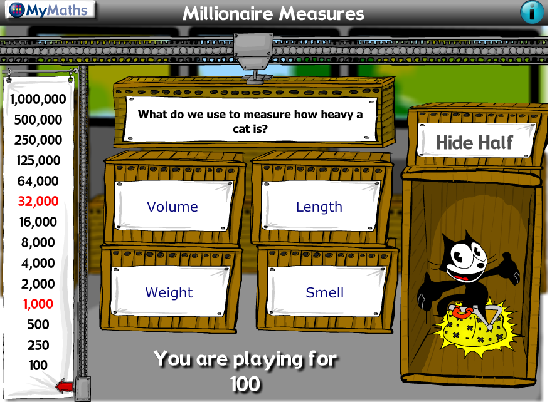
Mathematics
My Maths – Millionaire Measures
www.mymaths.co.uk

Slide 13
Literacy - Diary Writing Planning Sheet!

Slide 14
Literacy - Diary Writing
Its now time to start writing your diary. You can write it on hwb if you like! Use your planning sheet to help you and the word bank on the sheet.

Slide 15
Thursday

Slide 16
Mathematics
Active Learn- https://www.activelearnprimary.co.uk/start
Bubble Burst Game

Slide 17
Literacy – Comic Strip!
Can you write a comic strip for the film?
You can either use the sheet provided or make your own!

Slide 18
Friday

Slide 19
Mathematics
Active Learn- https://www.activelearnprimary.co.uk/start
Snaky Sums

Slide 20
Spelling!
Pattern: Suffix ‘ous’
Listen to the video and play the games!
https://www.activelearnprimary.co.uk/start

Slide 21
Inquiry Based Learning – Space!
History has been made as two Nasa astronauts have safely boarded the International Space Station (ISS). It's the first time that Nasa astronauts have been sent to space on a rocket owned by the private company, SpaceX. Your task this week is to find out more about their mission and make a 3D rocket! Please send pictures of your rockets to me so I can put them on the school website.
Challenge:
Survey the night sky. Make a diagram of what you see by plotting all of the stars, moons and planets that you observe. Use Apps and books to help you identify what’s above your head.

Slide 23
Well-being
Yoga
https://www.youtube.com/watch?v=02E1468SdHg
Joe Wicks
https://www.youtube.com/channel/UCAxW1XT0iEJo0TYlRfn6rYQ

Slide 24
Dance Mat Typing
Improve your typing skills with this fun typing tutor game!
https://www.bbc.co.uk/bitesize/topics/zf2f9j6/articles/z3c6tfr

Slide 25
Cymraeg
Scan the QR code for this week’s Welsh games.
Look at Pennard Primary’s Twitter Page for more Welsh games.
This Photo by Unknown Author is licensed under CC BY-SA
This Photo by Unknown Author is licensed under CC BY-SA

Slide 26
Take Care Stay Safe…..Have a good week!!!

