Slide 1
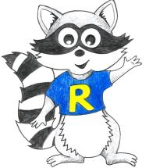
Home Learning
Year 4 – 18.5.20

Slide 3
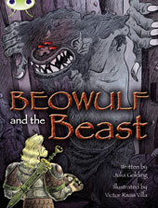
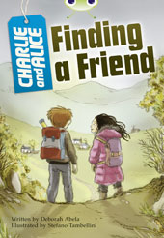
This Week’s Reading Books
I have allocated your reading books on Active Learn.
https://www.activelearnprimary.co.uk/start
This weeks reading books are:

Slide 4
Monday

Slide 5
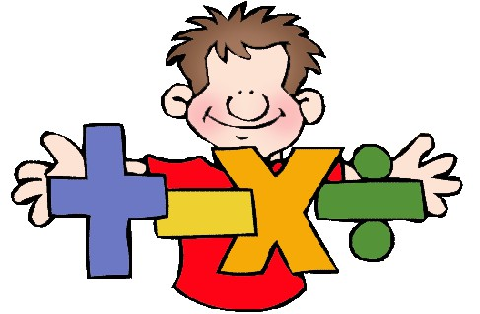
Mathematics
I have allocated your work on Abacus online.
Today’s activities are called:
Watch pupil video then….
Double and Subtract
&
Multiplying and Dividing by 10 and 100

Slide 6
Question Time

Slide 7
Tuesday

Slide 8
Mathematics
I have allocated your work on Abacus online.
Today’s activities are called:
Bonds to 100
&
Multiplication and Holes
&
Race to 200

Slide 9
Sick Sentences!
Don’t forget to use super sentences!

Slide 10
Sentence Challenge!
Don’t forget to use super sentences! Like the welly opener in the example!

Slide 11
Wednesday

Slide 12
Mathematics
I have allocated your work on Abacus online.
Today’s activities are called:
Using operations to make Numbers
&
Function Machine

Slide 13
Continue writing the story…
Use a RAP grid to help you, which you can find on the school website under ‘Useful Documents’.
Don’t forget those ‘Super Sentences’ and to write at least a page.
You don’t have to write the story starter just the rest of the story…

Slide 14
Thursday

Slide 15
Mathematics
I have allocated your work on Abacus online.
Today’s activities are:
Balloon Pop
&
Homework Sheet 4.15

Slide 16
Spelling!
Pattern: Common Prefixes
Listen to the video and play the games!
https://www.activelearnprimary.co.uk/start

Slide 17
Friday

Slide 18
Mathematics
I have allocated your work on Abacus online.
Today’s activities are:
Mastery Checkpoint 4.15.17
&
Mastery Checkpoint 4.15.18

Slide 19
Non-Fiction Writing
Write a non-chronological report about your favourite bird or the bird in the picture!
There will be an extra PowerPoint to hwb to remind you about how to write a report.

Slide 20
Throughout the week

Slide 21
Inquiry Based Learning
Step 1 - Research online what different animals teeth look like – pick one herbivore (e.g. Horse) and one carnivore (e.g.cat). Step 2 - Draw a picture of the animal and a diagram of its teeth. Step 3 - Find out about the diet of different animals and whether the animal is a herbivore or a carnivore. How does the animal feed? Alone? In a pack or herd? Where does the animal find its food? Describe what the teeth are like and what the animal uses them for. Step 4 - Now look in a mirror at your own teeth and compare their shape (form) to the teeth of the animals you researched. Think about what’s the same and what’s different. Step 5 - Find out about the importance of looking after your teeth and the correct way to brush your teeth.
Challenge: Write a set of instructions and draw or make a model of the inside of a tooth OR your mouth!

Slide 22
Dance Mat Typing
When you get back to school who is going to be able to type?!
https://www.bbc.co.uk/bitesize/topics/zf2f9j6/articles/z3c6tfr

Slide 23
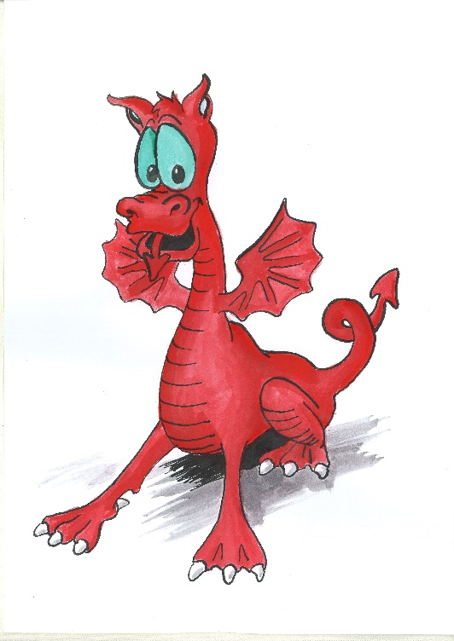
Cymraeg
Scan the QR code for this week’s Welsh games.
Look at Pennard Primary’s Twitter Page for more Welsh games.
This Photo by Unknown Author is licensed under CC BY-SA

