Slide 1




Home Learning
YeaR 3 – 08.06.20

Slide 3



This Week’s Reading Books
I have allocated your reading books on
Active Learn.
https://www.activelearnprimary.co.uk/start
This weeks reading books are:
Moya, The Luck Child
The Pirates in an Adventure with Scientists: Quest for Treasure

Slide 4
Monday

Slide 5

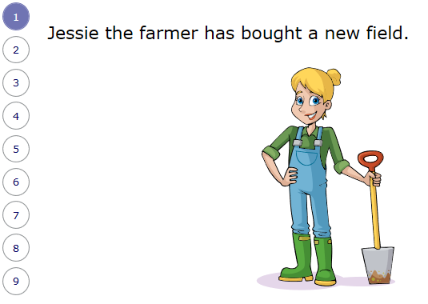
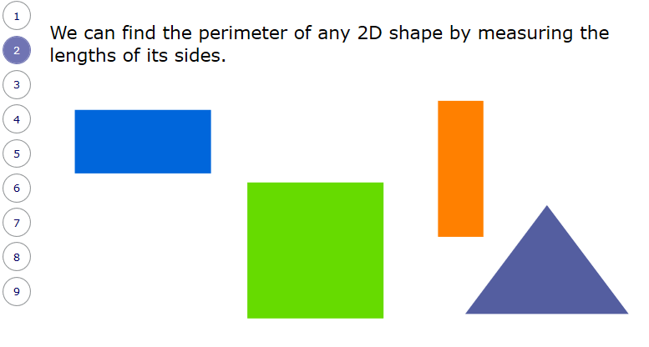

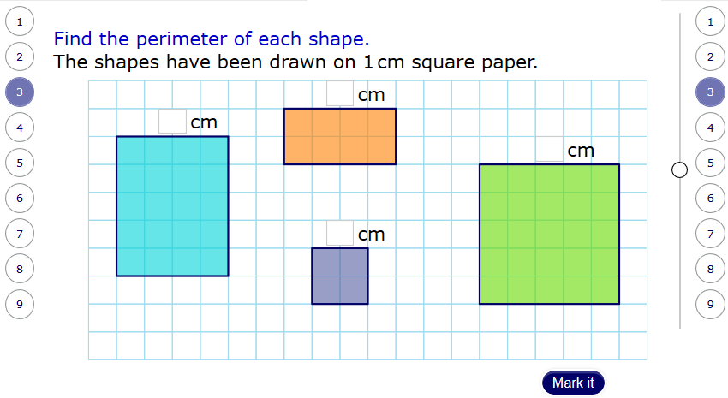
Mathematics
I have allocated your work on
My Maths online.
www.mymaths.co.uk
Today’s activity is :
Measuring Perimeter
(There are 9 parts to the whole chapter)
+
Homework sheet

Slide 6

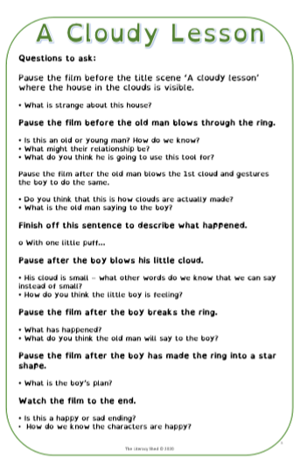

Literacy
Today’s activity is:
Watch the Pupil Video – A Cloudy Lesson
https://www.literacyshed.com/cloudylesson.html
&
Answer questions about the video

Slide 7
Tuesday

Slide 8
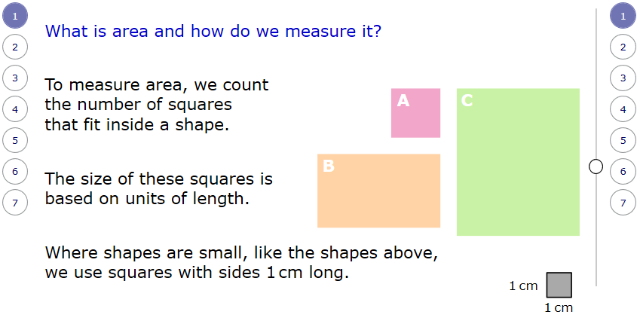
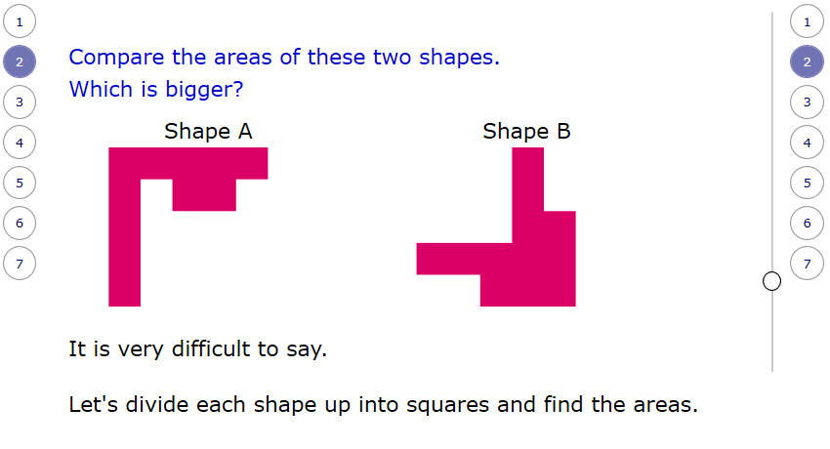
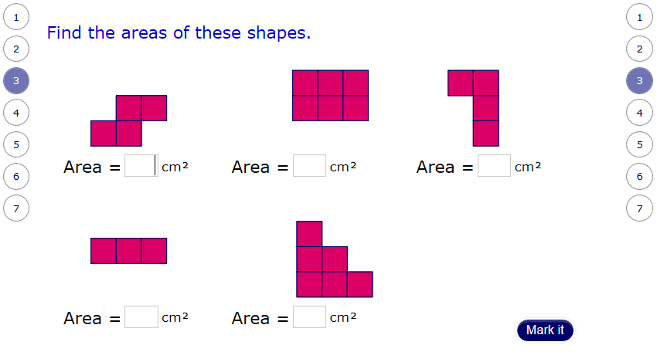
Mathematics
I have allocated your work on
My Maths online.
www.mymaths.co.uk
Today’s activity is:
Measuring Area
(There are 7 parts to the whole chapter)
&
Homework Sheet

Slide 9
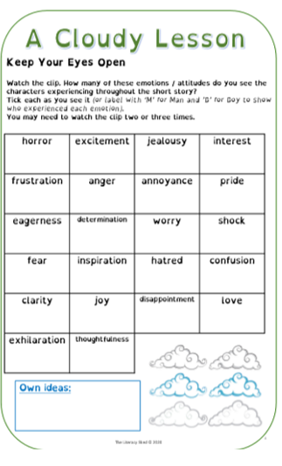

Literacy
Today’s activity is:
Keep your Eyes Open Sheet!
Emotions and Attitudes

Slide 10
Wednesday

Slide 11
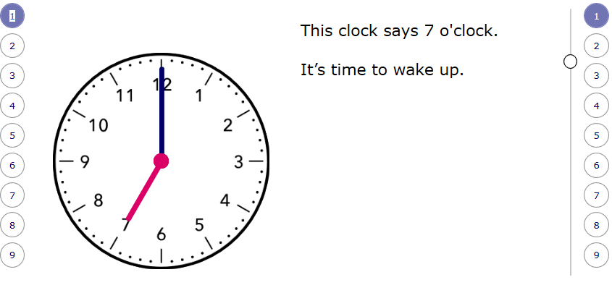
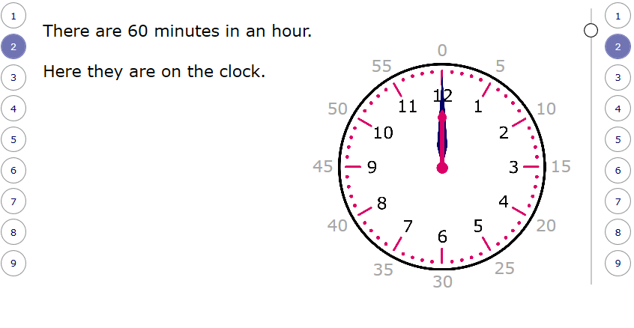
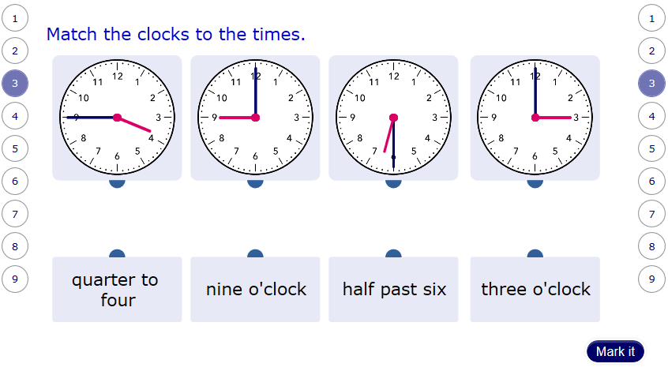
Mathematics
I have allocated your work on
My Maths online.
www.mymaths.co.uk
Today’s activity is:
Telling the Time
(There are 9 parts to the whole chapter)
&
Homework Sheet

Slide 12
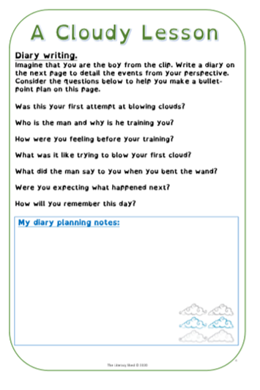
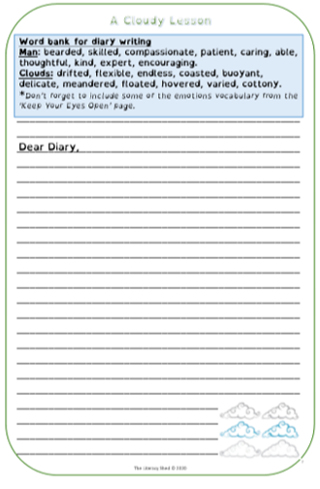
Literacy
Today’s activity is :
Planning and
Writing a Diary Entry

Slide 13
Thursday

Slide 14

Mathematics
I have allocated your work on Abacus online.
https://www.activelearnprimary.co.uk/start
Today’s activity is:
Bubble Burt Game
(Try All Levels)

Slide 15
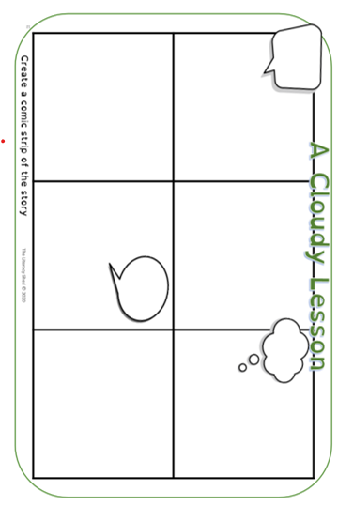
Literacy
Today’s activity is :
create a comic strip about a cloudy lesson

Slide 16
Friday

Slide 17
Mathematics
I have allocated your work on Abacus online.
https://www.activelearnprimary.co.uk/start
Today’s activity is:
Toucan Team Game
(Try All Levels)

Slide 18
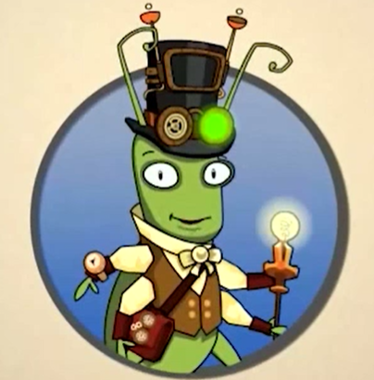
Spelling!
Pattern: Direct Speech
Play the games!
https://www.activelearnprimary.co.uk/start

Slide 19
Throughout the week

Slide 20

Inquiry Based Learning –
Into Space
History has been made as two Nasa astronauts have safely boarded the International Space Station (ISS). It's the first time that Nasa astronauts have been sent to space on a rocket owned by the private company, SpaceX.
Your task this week is to find out more about their mission and make a 3D rocket! Please send pictures of your rockets to me so I can put them on the school website
Challenge: Survey the night sky. Make a diagram of what you see by plotting all of the stars, moons and planets that you observe. Use Apps and books to help you identify what’s above your head.

Slide 21

Dance Mat Typing
When you get back to school who is going to be able to type?!
https://www.bbc.co.uk/bitesize/topics/zf2f9j6/articles/z3c6tfr

Slide 22

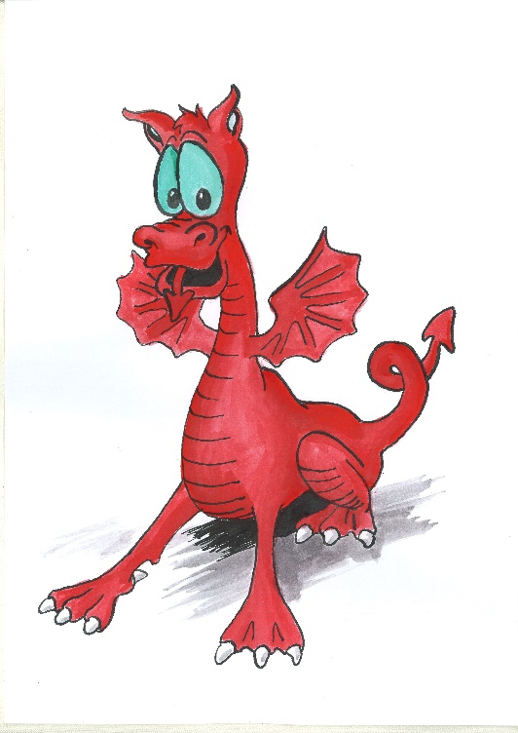
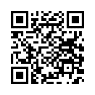
Cymraeg
Scan the QR code for this week’s Welsh games.
Look at Pennard Primary’s Twitter Page for more Welsh games.
This Photo by Unknown Author is licensed under CC BY-SA

